Slide 1



Hanover and Tyke
Home
Service
About Us
Contact
Starbucks
by Sudhanshu

Slide 2


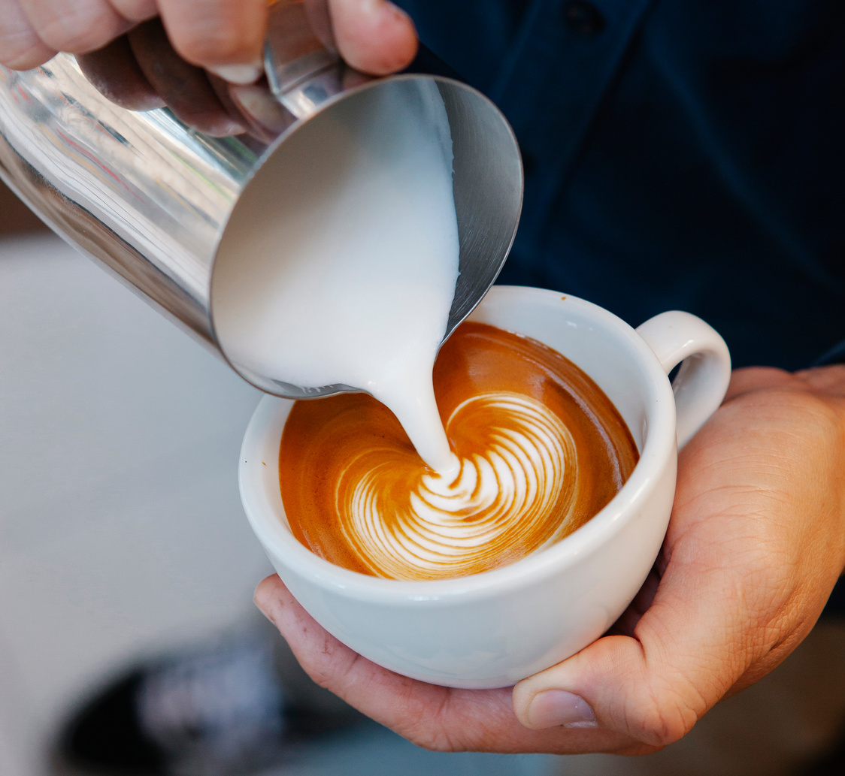
Hanover and Tyke
Home
Service
About Us
Contact
About Us
Starbucks is an American multinational chain of coffeehouses and roastery reserves headquartered in Seattle, Washington. It was founded in 1971 and is currently the world's largest coffeehouse chain.

Slide 3

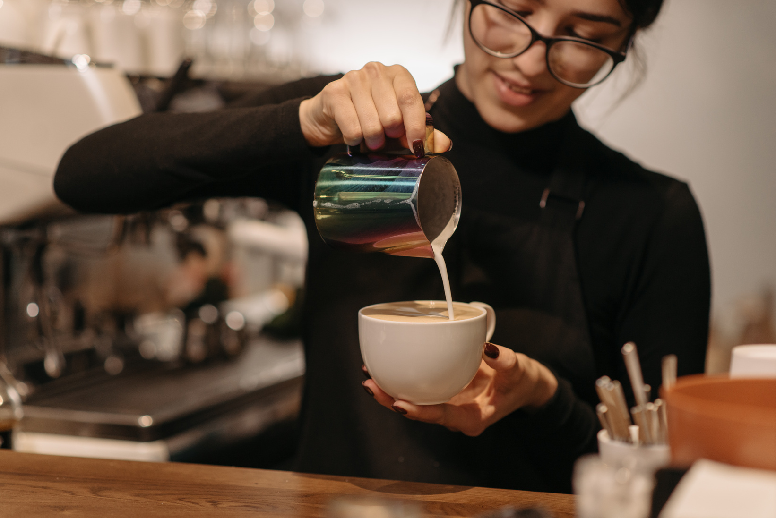

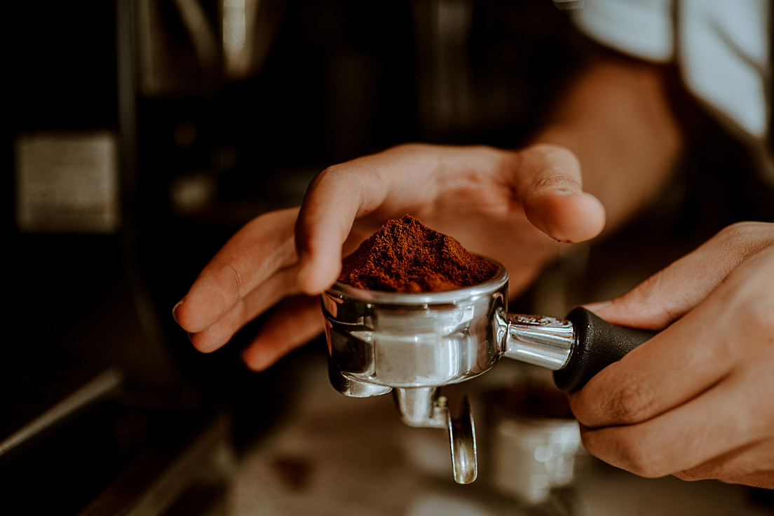

Hanover and Tyke
Home
Service
About Us
Contact
A summarised and visualised ppt on starbucks data

Slide 4

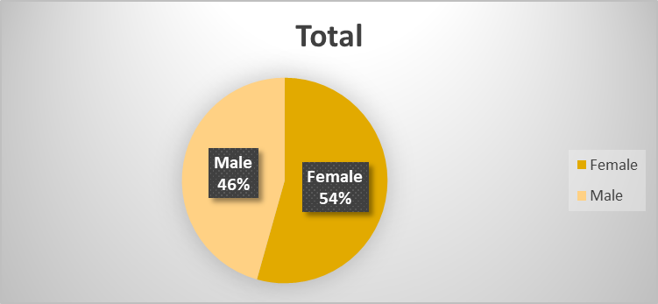
Gender Distribution of Customers
INTERPRETATION: Female customers are more so female centric coffee cups should be added,
more female employees will attract more customers.

Slide 5
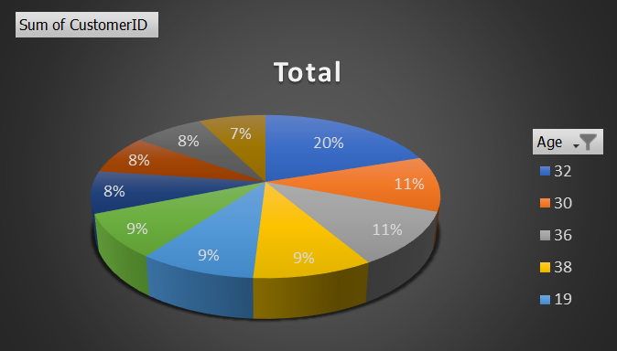
Age Distribution of Customers
INTERPRETATION: Age group between 30-36 are frequent customers,
working hours should be focused more for more better sales.

Slide 6
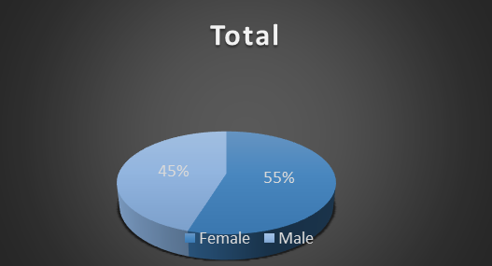
Average Purchase by Gender
INTERPRETATION:Female purchase is higher than males better
understanding female coffee choices will work more.

Slide 7
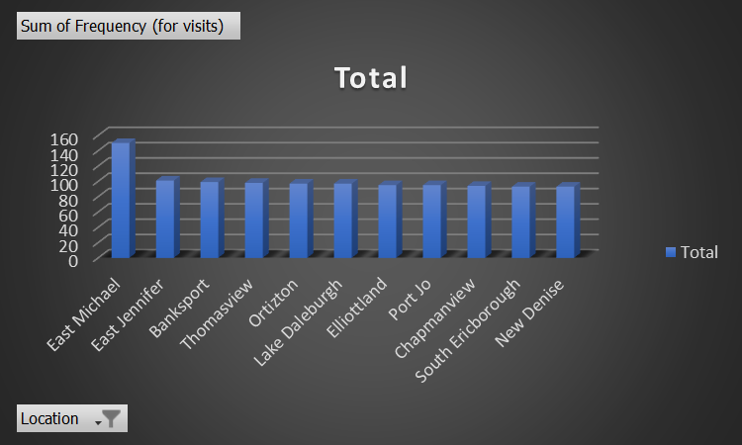
Frequency of Visits by Location
INTERPRETATION: East Michael and east Jennifer have very good
frequency of visits, we should study the demography, location,
coffee options of these to know what improvement we need in
other locations.

Slide 8
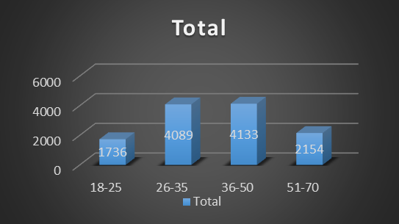
Average Purchase by Age Group
INTERPRETATION: Adults or working class are the frequent buyers,
studying or focusing on them will boost the sells.

Slide 9
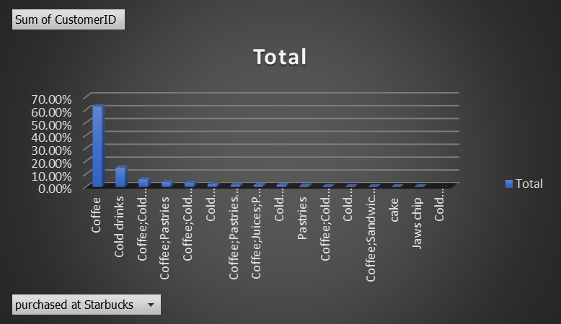
Percentage of Customers Who Purchased at Starbucks
INTERPRETATION: Coffee has the highest sales,
focusing on other products and their issues will increase their sales,
resulting in overall sales.

Slide 10
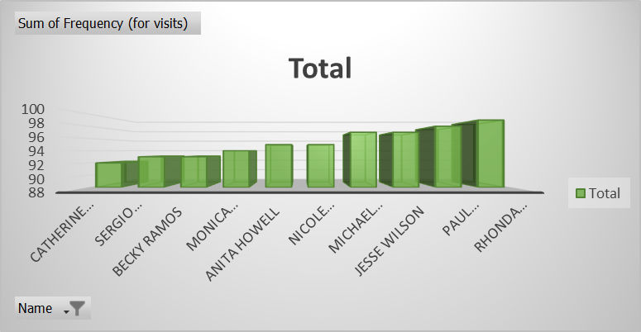
Customer Frequency Distribution
INTERTPRETATION: Customer visiting can be high but we can provide better
options and quality to increase the average purchase of individual customers.

Slide 11
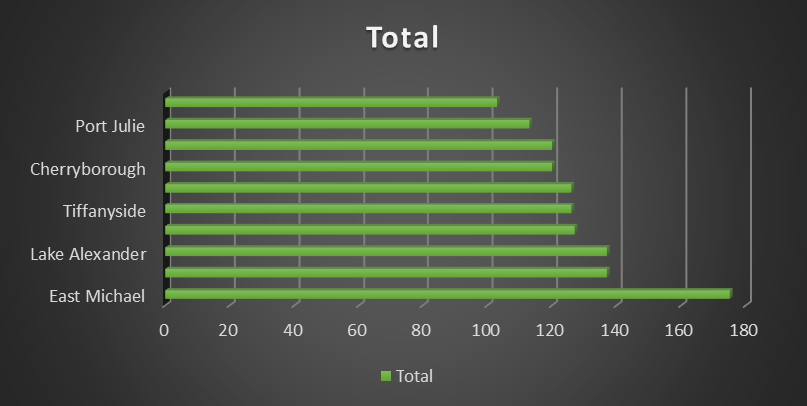
Top Locations by Total Purchases
INTERPRETATION: East Michael sales and service should be looked to
improve other locations as it's marginally high.

Slide 12
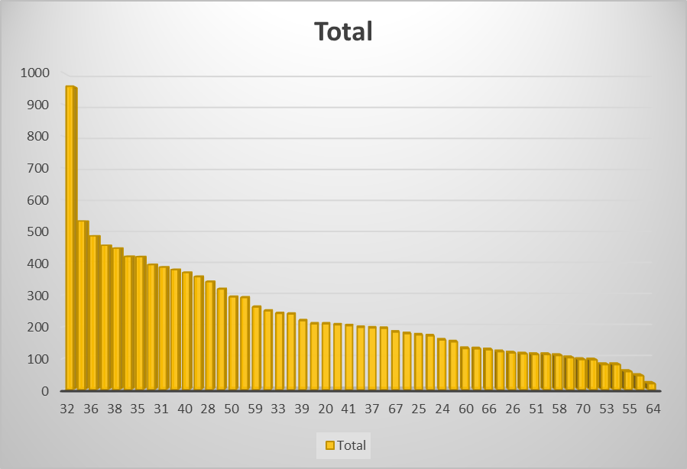
Customer Age vs. Average Purchase
INTERPRETATION: Age 32 has the highest number of purchases,
doing a survey to know the cause will help in future.

Slide 13
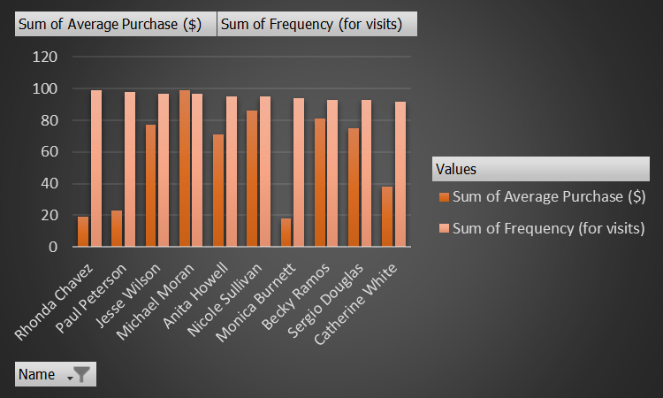
Frequency vs. Average Purchase
INTERPRETATION: More frequency doesn't affect the average purchase,
as low frequency visitors also have high average purchase.

Slide 14
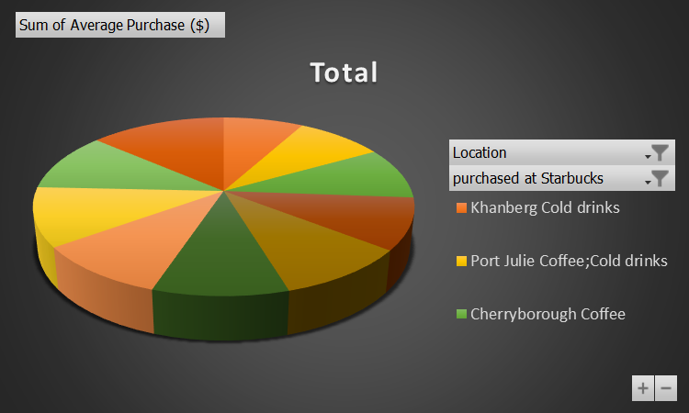
Customer Demographics Breakdown
INTRPRETATION: Coffee has the highest sales in almost every good performing
location, with cold drinks slipping in Port Julie a little and Tiffanyside with Pastries and Cookies.
Other products and services can do great if some changes were brought.

Slide 15
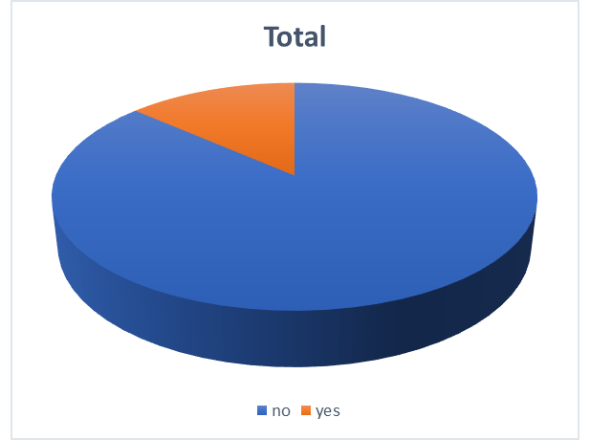
High-Spending Customers
INTERPRETATION: Customers in "yes" have average purchase more than 100$
so compared to low spending customers the percentage of high spending customers
is less than 1/4 of the whole, giving them rewards or something to please will
attract the low spending customers more.

